Slide 1
Generative AI in Software Development

Slide 2
Generative AI in Design Phase

Slide 3
In the previous lesson, we studied:
Generative AI helps create an efficient project plan based on various parameters, such as resource bandwidth, duration, complexity, and agenda.
It quickly generates a plan that is achievable with concrete outcomes.
It tailors to the planning pedagogy or model the team has decided to use, such as Agile and Scrum.
Notes:
Mode: Sync
Estimated duration: 5 mins
Type: Instructor-led
Instructor Note:
Quickly recap the points discussed in the previous lesson.

Slide 4
Imagine you are managing a design team assigned to create a mobile application for a travel company. The app aims to revolutionize how users interact with the company's products and services, incorporating personalized recommendations and intuitive user interfaces. As the design phase progresses, you recognize the complexity of the project and the need for a more creative approach and ideas.
How might Generative AI be leveraged to enhance the design process and streamline the development of complex features?
Notes:
Mode: Sync
Estimated duration: 10 mins
Type: Instructor-led whole group discussion
Instructor Note:
Facilitate a whole group discussion to kick off today’s lesson. Ensure that you do not spend much time discussing the answers. This slide aims to gain the learners’ attention and relate the lesson theme with relatable examples before starting with the actual lecture topic.

Slide 5
Create architectural design for an application, consolidating design requirements and finalizing elements of the UI using Generative AI
Utilize Generative AI tools to create the frontend of an application maintaining consistency in coding
Generate brandkit cards using Microsoft Designer to maintain visual and editorial consistency in the frontend
Develop a working prototype of an application demonstrating the working of different UI screens and functionalities
Notes:
Mode: Sync
Estimated duration: 2 minutes
Type: Instructor-led
Instructor Note:
State the learning objectives of the lesson.

Slide 6
Smart Designing with Generative AI
Notes:
Instructor Note:
Let us understand the ways of leveraging Generative AI for code generation in software development.

Slide 7







Phases in Software Development
After utilizing Generative AI in the planning phase, the next step is to understand the design and how Generative AI can be integrated into it.
Project planning
Requirement gathering and analysis
Designing
Implementation
Testing
Deployment
Support and maintenance
Notes:
Instructor Note:
Automated UI/UX Prototyping: Generative AI can quickly create UI/UX prototypes based on user requirements, suggesting design layouts and interaction flows optimized for usability. It analyses design trends and user behavior data to enhance interface effectiveness before development.
System Architecture Generation: AI can generate system architecture diagrams and component relationships by analysing existing patterns and performance needs. It helps suggest optimal configurations for databases, microservices, and APIs, improving scalability and reducing design time.

Slide 8

Design Phase in Software Development
The Design phase involves creating detailed architectural blueprints and user interfaces for the application or software and ensuring that functional and non-functional requirements are met.
Generative AI can be used in this phase to bring the requirements into a working prototype by making an attractive and user-friendly user interface of the application for all the functionalities.
Notes:
Instructor Note:
By leveraging Generative AI, developers and designers can streamline the UI design process, reduce the time required for repetitive tasks, and ensure that the end product is both visually appealing and user-friendly.

Slide 9
Design Phase Activities
System and Architecture Design: Establishing the overall structure and technology stack of the application
User Interface and User Experience Design: Crafting the layout, wireframes, and interaction flow of the user-facing part of the application
Security and API Design: Defining security measures and creating APIs to ensure secure data flow and communication between system components
Prototyping and Documentation: Developing prototypes to validate design decisions and preparing comprehensive documentation
Notes:
Instructor Note:
System and Architecture Design: Establishing the overall structure and technology stack of the application, including system architecture, database design, and component interactions. Example: Using a microservices architecture with React for the frontend and Node.js for the backend, and designing relational databases for user profiles, orders, and products.
User Interface and User Experience Design: Crafting the layout, wireframes, and interaction flow of the user-facing part of the application, ensuring it is user-friendly and visually appealing. Example: Designing wireframes for a mobile app's login and registration screens, and creating responsive designs for various devices.
Security and API Design: Defining security measures and creating APIs to ensure secure data flow and communication between system components. Example: Implementing encryption and authentication for sensitive data and designing RESTful APIs for handling social media posts and comments.
Prototyping and Documentation: Developing prototypes to validate design decisions and preparing comprehensive documentation for the development team to follow. Example: Building a clickable prototype of a dashboard for user feedback and writing technical specifications for system architecture and data flow.

Slide 10
How Can Generative AI Help?
System and architectural design
It can suggest optimal architecture patterns, database structures and relationships based on system requirements, like recommending microservices or monolithic architectures.
User interface and user experience
It can generate UI wireframes and layouts based on user input or design guidelines, quickly creating interactive prototypes.
Security and API design
It can automatically generate API endpoints and documentation based on system requirements and data models.
Prototyping and documentation
It can also automatically create working prototypes and detailed design documents, including technical specifications, architecture diagrams, and data flow descriptions.
Notes:
Instructor Note:
Generative AI in code generation involves using advanced AI models, like transformers and neural networks, to automatically create code. These models are trained on extensive datasets containing source code from various programming languages and frameworks.
Through this training, they learn common programming patterns and structures. This enables them to generate code snippets, functions, or even entire programs based on specific prompts or instructions, significantly aiding the software development process by automating repetitive tasks, improving consistency, and increasing efficiency.

Slide 11



Popular Generative AI Tools for Design Phase
AI-powered code completion tool providing real-time suggestions in the editor
AI tool by Amazon delivering real-time code suggestions
and completions
Conversational AI by OpenAI capable of assisting with various tasks, including code generation
Notes:
Instructor Note:
GitHub Copilot: AI pair programmer offering code suggestions within editors like VS Code, powered by OpenAI Codex.
Amazon Q: AI code review tool analysing repositories for feedback on code quality and adherence to best practices.
ChatGPT: OpenAI language model assisting with natural language tasks, including code-related text generation.

Slide 12



Popular Generative AI Tools for Code Generation
Conversational AI-powered tool to provide real-time code suggestions, autocompletion, and error handling.
Uizard features multimodal capabilities, blending text, images, modular layouts, UI elements, and context for advanced AI applications.
Snyk helps proactively incorporate security by identifying potential vulnerabilities in software architecture, dependencies, and third-party components before implementation begins.
Notes:
Instructor Note:
microsoft Copilot: AI pair programmer offering code suggestions within editors like VS Code, powered by OpenAI Codex.
Uizard: AI code review tool to build attractive UI/UX elements of an application
Snyk: AI-driven tool for security vulnerabilities and documentation of the application code

Slide 13




Industries Using Generative AI
Various industries globally are leveraging Generative AI technology for
designing an intuitive and user-friendly experience in different operations, such as:
Automates coding for proprietary medical applications storing medical records and diagnosis, enhancing efficiency in healthcare operations
Healthcare
Streamlines tasks like fraud detection and generates personalized investment portfolios
Finance
Enhances customer experiences by creating personalized product recommendations
Retail
Automates standard codes of various functionalities for the user interface and adapts according to the domain of the application
Software
Notes:
Instructor Note:
Generative AI is being widely implemented across several industries, transforming operations and enhancing productivity through automation and real-time insights.
Healthcare:
In healthcare, generative AI automates medical coding and diagnoses, helping to streamline administrative tasks and improving the speed of patient care. By analysing medical images, these AI models can help doctors identify health risks more accurately. Additionally, generative AI is playing a critical role in drug discovery, significantly reducing the time and cost involved in developing new medicines​.
Finance:
In the finance sector, generative AI helps streamline processes like fraud detection and risk assessment. It enables real-time analysis of vast financial datasets and provides personalized investment portfolios based on an individual’s risk profile and financial goals. However, while the benefits include efficiency and cost savings, there are concerns about transparency and biases in these AI-driven models​.
Retail:
Generative AI is transforming retail by enhancing customer experiences through personalized shopping recommendations. AI models analyze large amounts of customer data to offer product suggestions that align with individual preferences. This approach boosts engagement and sales by offering personalized virtual shopping experiences.
Software Development:
In software development, generative AI is being used in multiple ways, including automating code generation from natural language, detecting bugs, analysing security vulnerabilities, and generating unit tests. It improves productivity by handling repetitive tasks and even assists in creating documentation, making the codebase more readable and maintainable​.
This demonstrates the versatility of generative AI in automating tasks, improving decision-making, and enhancing operational efficiency across industries.

Slide 14
Business Benefits of Generative AI in Design Phase
Generative AI offers a range of capabilities to streamline and enhance the design process, including:
Faster time-to-market
Scalability
Error detection
and debugging
Cost efficiency
automates complex design tasks like creating system architecture diagrams, simulating design alternatives, and evaluating performance metrics, reducing manual iterations
adapts to varying design requirements, optimizing architectures or microservices by simulating performance under different conditions, enabling easy scalability
Helps in identifying potential bugs and suggests fixes
optimize resource allocation and avoid unnecessary costs from design rework or inefficient system architecture.
Notes:
Instructor Note:
Faster Time-to-Market: Generative AI automates complex design tasks like creating system architecture diagrams, simulating design alternatives, and evaluating performance metrics, reducing manual iterations and accelerating development cycles.
Cost Efficiency: By generating and testing multiple design options using AI algorithms, teams can optimize resource allocation and avoid unnecessary costs from design rework or inefficient system architecture.
Improved Innovation: AI-driven models explore vast design spaces, suggesting novel patterns or component configurations in software, system architecture, and UI/UX, pushing the boundaries of traditional human design approaches.
Error Reduction: Generative AI tools detect potential design flaws, such as security vulnerabilities, scalability issues, or inefficient data flows, by simulating different scenarios, reducing the chances of post-implementation bugs or system failures.
Enhanced Collaboration: AI-powered platforms provide interactive design environments where cross-functional teams—developers, architects, and security professionals—can visualize system architecture, enabling real-time feedback and collaborative optimization.
Scalability: AI-generated designs adapt to varying system loads, optimizing architectures for cloud environments, distributed systems, or microservices by simulating performance under different conditions, enabling easy scalability.
Security by Design: Generative AI integrates security best practices into the design phase, identifying potential attack vectors or compliance gaps, and suggesting secure architectures, ensuring robust defense mechanisms from the outset.

Slide 15
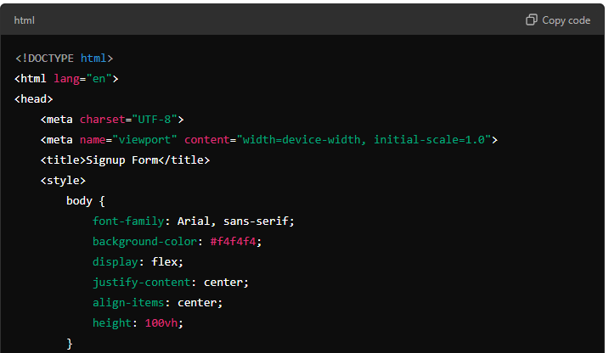
Generative AI in Design Phase: Example
Example
Task: Develop a basic signup system with user inputs
AI assistance: The GenAI tool generates a HTML code for user registration functionality
Notes:
Instructor Note:
Highlight the example of developing a signup system, where users input their credentials and gain secure access to personalized features.
Walk through the provided code example, showing how the AI suggests (code from username till return False) and completes code to create a basic login function.

Slide 16
Generative AI: Architectural Design
Notes:
Instructor Note:
Let us understand how to utilize Generative AI for architectural design

Slide 17
Requirements of Architectural Design
It sets the foundational blueprint for a software system, guiding its development and evolution. The following are the key components:
Purpose and goals
01
Define the primary objective that aligns with business strategy
Functional requirements
Identify the essential function that system must perform
02
Non-Functional requirements
03
Define quality attributes like performance, scalability, and more
Notes:
Instructor Note: Purpose & Goals:
Define the system's primary objectives.
Align architecture with business strategy and user needs.
Functional Requirements:
Identify essential functions the system must perform.
Clarify user interactions, processes, and expected outcomes.
Non-Functional Requirements (Quality Attributes):
Performance: Specify response time, throughput, and utilization targets.
Scalability: Define expectations for growth in user base and data volume.
Reliability: Establish the desired level of system uptime and fault tolerance.
Maintainability: Determine the ease of system updates and bug fixes.
Security: Outline required compliance standards and security protocols.

Slide 18
Requirements of Architectural Design
Constraints
04
Recognize limitations in budget, time, technology, and resources
Stakeholder analysis
Gather input from end-users, clients, developers, and other stakeholders
05
Notes:
Instructor Note:
Constraints:
Recognize limitations in budget, time, technology, and resources.
Address regulatory, hardware, and software constraints.
Stakeholder Analysis:
Gather input from end-users, clients, developers, and other stakeholders.
Ensure all perspectives are considered to meet diverse needs.
Let us discuss scalability and performance

Slide 19
What Is Architectural Design?
Architectural design in SDLC is the process of defining a structured solution that meets all the technical and operational requirements while maintaining quality and performance.
The key activities include:
High-level structure
01
Includes identifying the software components, modules, interfaces, and data flows
Technology stack
Involves selecting the appropriate technology stack, such as frameworks and libraries that aligns with the project’s requirements.
02
Architectural pattern and documentation
03
Identifies patterns like microservices, monolithic architecture, and layered architecture along with detailed documentation
Notes:
Instructor Note:
Architectural design in software or application development is the process of defining a structured solution that meets all the technical and operational requirements while optimizing common quality attributes such as performance, security, and manageability. It serves as a blueprint for both the system and the project, laying out the foundational structure upon which the software or application is built.
Key Aspects of Architectural Design:
High-Level Structure: It involves defining the high-level structure of the software system. This includes identifying the software components, modules, interfaces, and data flows, as well as how they interact with one another.
Abstraction: The design abstracts the complex problem into manageable pieces. This helps developers understand the system in terms of its major components without getting bogged down in implementation details.
Technology Stack: Architectural design also involves selecting the appropriate technology stack (e.g., programming languages, frameworks, libraries) that aligns with the project’s requirements.
Quality Attributes: It addresses key non-functional requirements, such as scalability, reliability, performance, security, and maintainability, ensuring the system can meet these expectations.
Architectural Patterns: Common architectural patterns like microservices, monolithic architecture, service-oriented architecture (SOA), and layered architecture are considered to solve recurring design problems.
Documentation: Detailed documentation is created during the architectural design process. This documentation serves as a reference for developers and stakeholders, guiding the implementation and future modifications.
Decision-Making: Architectural design involves making critical decisions about how the system will be structured. These decisions have long-term impacts on the system’s flexibility, robustness, and ability to evolve with changing requirements.

Slide 20
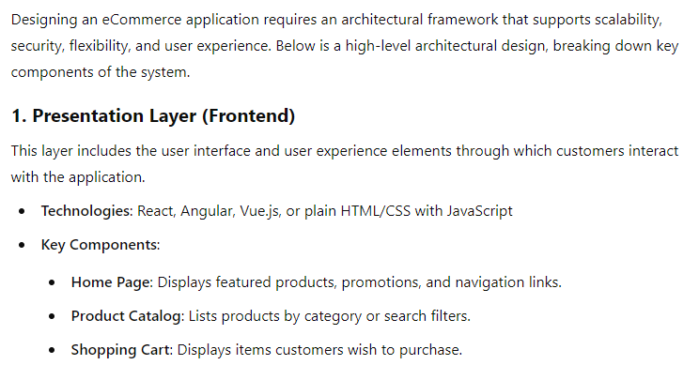
Example: Generative AI for Architectural Design
Example
Prompt: Develop a basic architectural design for an ecommerce application
AI assistance: The GenAI tool generates a complete structure of the application with different layers in the application for both frontend and backend.
Notes:
Instructor Note:
Faster Time-to-Market: Generative AI automates complex design tasks like creating system architecture diagrams, simulating design alternatives, and evaluating performance metrics, reducing manual iterations and accelerating development cycles.
Cost Efficiency: By generating and testing multiple design options using AI algorithms, teams can optimize resource allocation and avoid unnecessary costs from design rework or inefficient system architecture.
Improved Innovation: AI-driven models explore vast design spaces, suggesting novel patterns or component configurations in software, system architecture, and UI/UX, pushing the boundaries of traditional human design approaches.
Error Reduction: Generative AI tools detect potential design flaws, such as security vulnerabilities, scalability issues, or inefficient data flows, by simulating different scenarios, reducing the chances of post-implementation bugs or system failures.
Enhanced Collaboration: AI-powered platforms provide interactive design environments where cross-functional teams—developers, architects, and security professionals—can visualize system architecture, enabling real-time feedback and collaborative optimization.
Scalability: AI-generated designs adapt to varying system loads, optimizing architectures for cloud environments, distributed systems, or microservices by simulating performance under different conditions, enabling easy scalability.
Security by Design: Generative AI integrates security best practices into the design phase, identifying potential attack vectors or compliance gaps, and suggesting secure architectures, ensuring robust defense mechanisms from the outset.

Slide 21
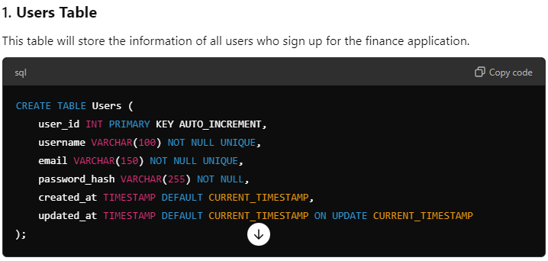
Example: Generative AI for Architectural Design
Example
Prompt: Develop a basic database structure for a finance application
AI assistance: The GenAI tool generates a complete DB structure of the application with different tables and their relationship.
Notes:
Instructor Note:
Faster Time-to-Market: Generative AI automates complex design tasks like creating system architecture diagrams, simulating design alternatives, and evaluating performance metrics, reducing manual iterations and accelerating development cycles.
Cost Efficiency: By generating and testing multiple design options using AI algorithms, teams can optimize resource allocation and avoid unnecessary costs from design rework or inefficient system architecture.
Improved Innovation: AI-driven models explore vast design spaces, suggesting novel patterns or component configurations in software, system architecture, and UI/UX, pushing the boundaries of traditional human design approaches.
Error Reduction: Generative AI tools detect potential design flaws, such as security vulnerabilities, scalability issues, or inefficient data flows, by simulating different scenarios, reducing the chances of post-implementation bugs or system failures.
Enhanced Collaboration: AI-powered platforms provide interactive design environments where cross-functional teams—developers, architects, and security professionals—can visualize system architecture, enabling real-time feedback and collaborative optimization.
Scalability: AI-generated designs adapt to varying system loads, optimizing architectures for cloud environments, distributed systems, or microservices by simulating performance under different conditions, enabling easy scalability.
Security by Design: Generative AI integrates security best practices into the design phase, identifying potential attack vectors or compliance gaps, and suggesting secure architectures, ensuring robust defense mechanisms from the outset.

Slide 22
Generating Microservice Architecture Using Generative AI
15
Demonstrate the process of generating microservice architecture using generative AI
You are tasked with designing the microservice architecture for critical components of an e-commerce platform, focusing on enhancing functionality and user experience.
This demonstration reveals how generative AI, specifically a Software Architecture GPT, is employed to generate detailed architectures for a login page, add to cart page, payment page, and purchase page. Each component is carefully designed to ensure security, seamless integration, and efficient transaction handling, with the AI providing both textual descriptions and ASCII art diagrams.
Note: Refer to the demo document for detailed steps:
01_Generating_Microservice_Architecture_Using_Generative_AI
Notes:
Instructor Note:​
Please demonstrate the actions specified on the slide. Additionally, encourage the learners to actively participate by performing the tasks along with you during the demonstration.​
For further guidance, you can refer to the elaborated demo document.​
Please guide the learners to download the demo documents available on the Learning Management System (LMS) under the section titled 'Reference Materials'.

Slide 23
Generative AI for UI/UX
Notes:
Instructor Note:
Let us understand the ways of leveraging Generative AI for code generation in software development.

Slide 24

User Interface (UI) Design
It encompasses all the elements that enable users to interact with a product or service, including buttons, icons, spacing, typography, color schemes, and responsive design.
The goal of UI is to create a seamless and visually appealing interface that users find intuitive
and enjoyable.
Notes:
Instructor Note UI design is all about creating the look and feel of the product - making it visually appealing and arranging elements in a way that makes sense to users.
The visual and interactive components that facilitate user-product interaction are included in user interface (UI) design.
Icons represent ideas, buttons help activities, and space arranges material for ease of reading.
Typography improves both visual appeal and readability. Color palettes express mood and information hierarchy.
Adaptability on different devices is ensured with responsive design.
Creating visually appealing and intuitive interfaces that improve functionality and user experience is the goal of UI design.

Slide 25
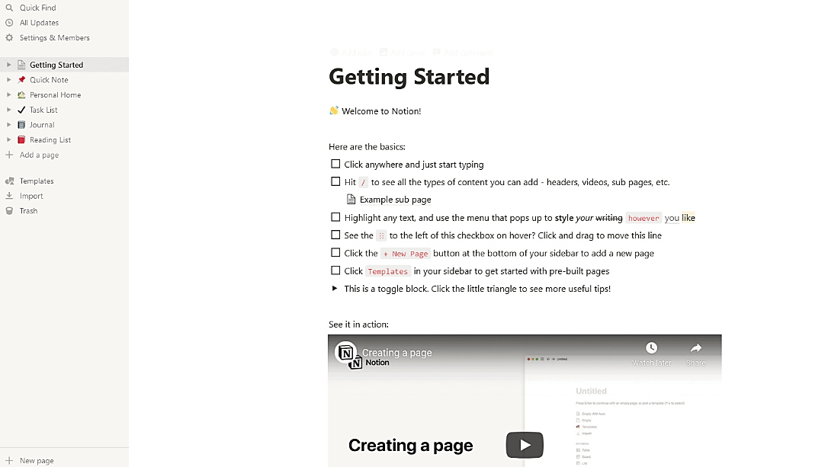
Example of a UI Design
Notion's onboarding process begins on a clear and well-structured Getting started page, providing instructions in easy-to-follow steps and a list to track and check off progress.
Source: https://www.notion.so/Getting-Started-10e9cc2258f380cfbef4f75b047f1c68
Notes:
Instructor Note Discuss this UI example of Notion Notion's onboarding process kicks off with a user-friendly "Getting Started" page. This page provides clear instructions in easily digestible steps. Users are guided through the setup with a structured checklist, allowing them to track their progress and stay motivated. Additionally, helpful resources such as videos and articles are provided to further assist users in familiarizing themselves with the platform.

Slide 26
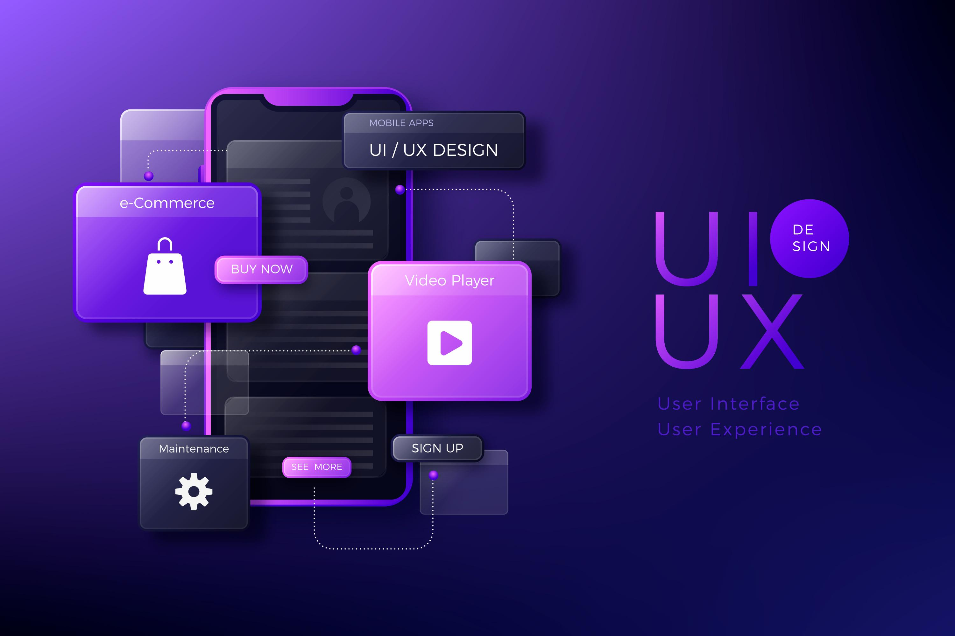
User Experience (UX) Design
It is the process of enhancing user satisfaction by improving the usability, accessibility, and overall experience during interactions with a product.
It involves a comprehensive understanding of users and their needs to create a seamless journey through the product.
Notes:
Instructor Note UX design focuses on the overall user experience - understanding how people use the product, making sure it's easy to navigate, and ensuring that everything flows smoothly.
Enhancing customer satisfaction via optimal usability, accessibility, and total product engagement is the goal of user experience (UX) design. A thorough comprehension of user demands is necessary to provide a smooth user experience with the product.
Research, prototyping, and testing are all included in UX design to ensure meaningful engagement and easy navigation.
It seeks to produce effective, pleasurable, and gratifying experiences. User feedback is considered during this iterative process to constantly enhance the product.
Finally, UX design aims to provide solutions that satisfy users' requirements and go above and beyond their expectations, increasing their happiness and loyalty.

Slide 27
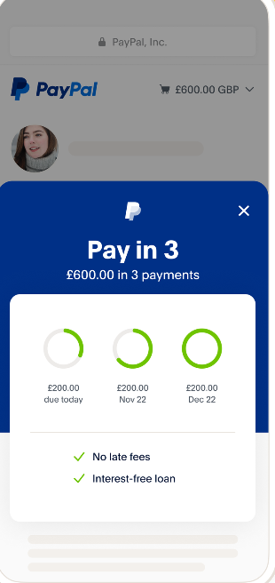
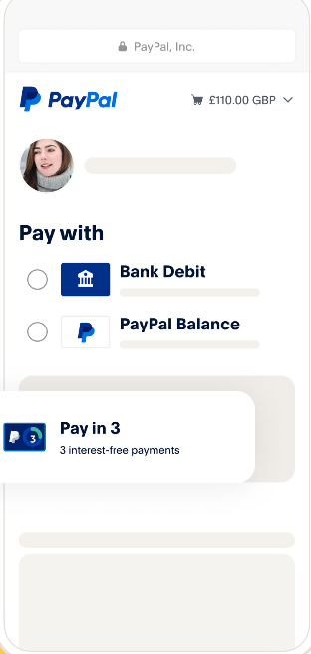
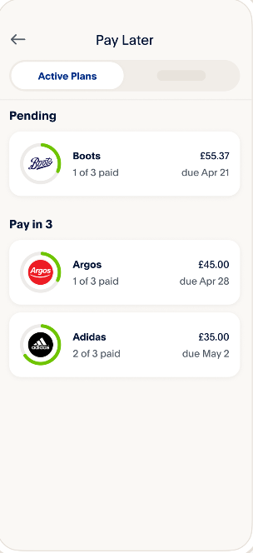
Example of a UX Design
PayPal has simplified its website and mobile app experience, making all functions easy to find and use.
Notes:
Instructor Note Discuss this UX example of PayPal. Simplified Navigation
Streamlined Checkout Process
Consistent Design Language
Responsive Design
User Feedback Integration

Slide 28
Interdependence of UI and UX
UI and UX are interdependent; one is about the look and the other about the feel.
UI cannot exist without UX
UI focuses on the tangible elements that users interact with, and the UX defines the context and efficiency of those interactions.
UI brings the user experience UX to life
UI acts as the bridge between the user and the digital environment, translating UX strategies into tangible interfaces.
Notes:
Instructor Note Discuss further about UI and UX: Both need to be synchronized to create products that are not only visually appealing but also functionally rewarding for the user.
UI and UX work hand in hand to create effective digital experiences. Because UX provides the context and efficiency of those interactions, UI deals with the tangible elements users interact with.
Additionally, it serves as a bridge between the user and the digital world and converts UX strategies into concrete interfaces.
By prioritizing user enjoyment and usability, UI and UX collaborate harmoniously to provide unified and intuitive designs that ultimately increase the overall efficacy of digital goods and services.

Slide 29
Generative AI in UI/UX Design
It helps in following stages of UI and UX design:
Idea exploration
Generates numerous design variations based on given parameters
Layout creation
Automates layout based on design principles and user preferences
Color
schemes innovation
Analyzes color theory and trends to produce harmonious palettes
Typography
enhancement
Analyzes typographic trends and user preferences to suggest suitable fonts and typography styles
Responsive design adaptation
Optimizes UIs for various devices by suggesting layout adjustments and responsive techniques
Notes:
Instructor Note Idea Generation and Exploration: By inputting design parameters and constraints, AI can generate numerous design variations, helping designers explore different possibilities efficiently
Layout and Composition: AI-powered tools can automate the process of creating layouts and compositions for user interfaces. By analysing design principles and user preferences, generative AI can suggest or generate layouts that optimize usability and visual appeal.
Color Palette Generation: Generative AI can analyze color theory principles and trends to generate harmonious color palettes for user interfaces. Designers can input preferences or brand guidelines, and AI algorithms can produce color schemes that align with the desired aesthetic.
Typography Suggestions: AI algorithms can analyze typographic trends and user preferences to suggest suitable fonts and typography styles for user interfaces. Generative AI can help designers experiment with different font pairings and styles to achieve the desired visual hierarchy and readability.
Responsive Design Adaptation:
AI optimizes UIs for various devices by suggesting layout adjustments and responsive techniques for consistent user experiences.

Slide 30
Generative AI in UI/UX Design
Image and
icon generation
Assists in creating tailored images, icons, and graphics that enhance the design aesthetic
User experiences
Customizes interfaces to individual preferences for a more engaging and relevant experience
Content development
Ensures consistency across product descriptions, headlines, and interface copy
Usability insights
Forecasts user interaction and identifies usability challenges before live deployment
Design collaboration
Streamlines collaboration by automating feedback analysis and offers actionable insights
Notes:
Instructor Note Image and Icon Generation: Generative AI can assist in creating custom images, icons, and graphics for user interfaces. By understanding design requirements and preferences, AI algorithms can generate visuals that complement the overall design aesthetic and convey information effectively.
User Personalization: Generative AI can leverage user data and machine learning algorithms to create personalized user experiences. By analysing user preferences, behavior patterns, and demographics, AI can customize user interfaces to meet individual needs and preferences.
Content Generation: AI algorithms can generate textual content, such as product descriptions, headlines, or interface copy, based on predefined templates and input data. Generative AI can automate the process of content creation, saving time for designers and ensuring consistency in messaging.
Usability Testing Simulation: AI-powered simulations can predict user interactions and behaviors within user interfaces, helping designers identify potential usability issues before deployment. Generative AI can simulate user testing scenarios and provide insights into the effectiveness of design choices.
Design Collaboration and Feedback: Generative AI can facilitate collaboration among design teams by automating feedback collection and analysis. AI-powered tools can gather feedback from stakeholders or users, analyze it for insights, and provide actionable recommendations to improve the design process.
Generative AI can also be used to build entire user interfaces from scratch. By inputting basic requirements and parameters, such as user needs and design constraints, the AI can autonomously generate comprehensive UI designs.

Slide 31
Generating UI Design Using Uizard
15
Demonstrate the process of generating UI design using Uizard
You are responsible for developing the user interface (UI) for a grocery company’s web application using Uizard. Your goal is to create a connected and stylish design.
This demonstration illustrates how Uizard AI facilitates the creation of a web application. Setting design preferences to ‘Modern and Elegant’ for GroceryGo, which features various interconnected pages like a homepage, user profile, cart, and wishlist, Uizard efficiently produces a cohesive and visually appealing interface.
Note: Refer to the demo document for detailed steps:
02_Generating_UI_Design_Using_Uizard
Notes:
Instructor Note:​
Please demonstrate the actions specified on the slide. Additionally, encourage the learners to actively participate by performing the tasks along with you during the demonstration.​
For further guidance, you can refer to the elaborated demo document.​
Please guide the learners to download the demo documents available on the Learning Management System (LMS) under the section titled 'Reference Materials'.

Slide 32
Generating Cards Using Microsoft Designer
15
Demonstrate the process of generating cards using Microsoft Designer
You are creating a greeting card for Freshbar, a company that specializes in milk products using Microsoft Designer to enhance its visual communication.
This demonstration details how Microsoft Designer is utilized to craft a unique greeting card that reflects the brand’s identity. Starting from selecting a style from the card design options to customizing the content to reflect Freshbar’s efficient supply chain and product range, the process is streamlined for ease and creativity.
Note: Refer to the demo document for detailed steps:
03_Generating_Cards_Using_Microsoft_Designer
Notes:
Instructor Note:​
Please demonstrate the actions specified on the slide. Additionally, encourage the learners to actively participate by performing the tasks along with you during the demonstration.​
For further guidance, you can refer to the elaborated demo document.​
Please guide the learners to download the demo documents available on the Learning Management System (LMS) under the section titled 'Reference Materials'.

Slide 33
You are a UI/UX designer working on a mobile app for an e-commerce platform. The team wants to improve the user interface to increase customer engagement and make product recommendations more intuitive. They decide to integrate Generative AI to assist in this process. How can Generative AI best assist you in improving the app's user interface to enhance the user experience?
By randomly generating new interface layouts without considering user data
By analysing user interaction patterns and generating personalized UI design suggestions tailored to individual users
By fully automating the UI design process, eliminating the need for designer input
By automating A/B testing of UI designs without any user feedback
Notes:
Mode: Sync
Estimated duration: 5 minutes
Type: Poll Question
Instructor Note:
Conduct the poll and, if necessary, reteach key points based on the results before starting with the next topic.
Provide feedback or explanations after the poll, where appropriate, so learners can understand why certain answers are correct or incorrect.
If most of the class is getting the poll incorrect, then there is a gap in their understanding. Prompt the learners to highlight which concepts are unclear to them and teach those topics for the understanding of the whole class. Move onto the next topic when the class is confident in their understanding of the section.
Correct Answer: B) By analysing user interaction patterns and generating personalized UI design suggestions tailored to individual users.
Explanation: Generative AI uses data-driven insights to suggest personalized UI enhancements based on user interactions, optimizing the interface for better user satisfaction and engagement.

Slide 34
Personalization and Customization in UI/UX Design

Slide 35

Personalization in UI and UX Design
Definition
It involves dynamically adjusting content and interactions to align with users’ preferences, behaviors, and past interactions.
Example
Example: An online store gives you product recommendations based on your
recent searches.
Notes:
Instructor Note Personalization dynamically tailors content, features, and interactions based on individual user characteristics, behavior, and history. It improves relevance and engagement by offering curated content and recommendations using data such as browsing history and demographics. Often driven by algorithms and machine learning Example.: An online store gives you product recommendations based on your recent searches.

Slide 36

Customization in UI and UX Design
Definition
It refers to allowing users to modify certain aspects of the interface or functionality according to their preferences.
Example
Example: A music app asks you to choose
genres or artists you like to create your
personal music feed.
Notes:
Instructor Note Customization refers to allowing users to modify certain aspects of the interface or functionality according to their preferences. This could involve adjusting settings, layouts, themes, or features to better suit individual tastes or requirements.
Customization provides users with a sense of control over their experience, empowering them to tailor the product to their liking.

Slide 37
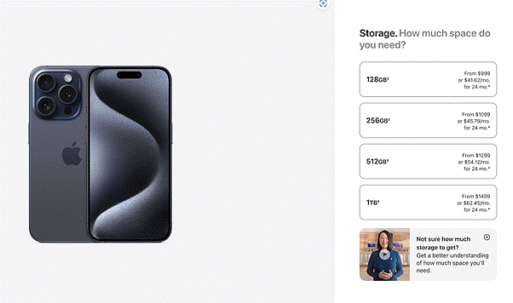
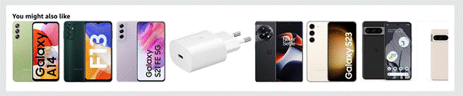
Examples
Customization
Apple allows users to customize device types, colors, and specifications, providing them with a sense of ownership and personalization.
Personalization
Amazon provides personalized product recommendations based on users' browsing history, purchase history, and preferences.
Notes:
Discuss these examples on customization and personalization with the learners Apple allows users to customize device types, colors, and specifications, providing them with a sense of ownership and personalization. Amazon provides personalized product recommendations based on users' browsing history, purchase history, and preferences.

Slide 38
Types of Personalization
Content personalization
It includes personalizing the content users see based on their preferences, past behaviors, or demographics to increase relevance and engagement.
Interface personalization
It includes adapting the visual elements of the UI, such as layout, theme, and navigation, to match the user’s preferences and usage patterns.
Interaction personalization
It includes modifying the way the product interacts with the user, including personalized recommendations, adaptive user journeys, and tailored communication to enhance the user experience.
Notes:
Instructor Note Discuss the three types of personalization. By integrating these types of personalization into UI/UX design, you can create more intuitive and engaging digital products that resonate deeply with users
1. Content personalization: This involves tailoring the content users encounter based on factors like their preferences, past actions, or demographic information, to enhance relevance and engagement. 2. Interface personalization: This pertains to adjusting the visual aspects of the user interface, such as layout, theme, and navigation, to align with individual user preferences and usage habits. 3. Interaction personalization: This refers to customizing how the product interacts with users, encompassing personalized recommendations, adaptive user journeys, and tailored communication strategies, all aimed at improving the overall user experience.

Slide 39
Example: Enhancing UX with Personalization and Customization
Scenario
E-commerce company ABC needed to create a compelling shopping experience to differentiate itself in the competitive market.
Solution
ABC implemented personalization and customization, offering tailored product recommendations based on user data and allowing users to adjust settings as per
their preferences.
Outcome
Personalization and customization increased user engagement, satisfaction, and loyalty, leading to improved metrics like time spent on the platform and conversion rates.
Notes:
Instructor Note: Discuss this case study on personalization and customization

Slide 40
Imagine you are the product manager for a music streaming application aiming to improve user satisfaction. In this context, which type of personalization would be crucial for adjusting the application's operational behavior and functionality to align with individual user habits and preferences?
Content personalization
Aesthetic personalization
Interaction personalization
Visual personalization
Notes:
Mode: Sync
Estimated duration: 5 minutes
Type: Poll Question
Instructor Note:
Conduct the poll and, if necessary, reteach key points based on the results before starting with the next topic.
Provide feedback or explanations after the poll, where appropriate, so learners can understand why certain answers are correct or incorrect.
If most of the class is getting the poll incorrect, then there is a gap in their understanding. Prompt the learners to highlight which concepts are unclear to them and teach those topics for the understanding of the whole class. Move onto the next topic when the class is confident in their understanding of the section.
Correct Answer: A
Explanation: Content personalization is crucial in a music streaming application for adjusting the app's operational behavior and functionality to align with individual user.

Slide 41
Enhancing User Flow and Navigation

Slide 42
Importance of User Flow and Navigation in UI and UX Design
User flow defines the path users take to achieve their goals, and navigation systems guide users effortlessly through an application. The following points highlight their importance:
Guides the user journey
Improves conversion rates
01
04
Importance
Enhances user experience
Facilitates better design decisions
02
05
Identifies pain points
03
06
Supports consistency
Notes:
Instructor Note
Guides the User Journey: User flow is the path taken by a user on a website or app to complete a task. It’s like a roadmap that guides users to their destination without getting lost.
Enhances User Experience: Good navigation helps create a seamless experience, allowing users to find information quickly and efficiently. It reduces frustration and ensures that the user’s journey through the product is logical and intuitive.
Identifies Pain Points: By mapping out user flows, designers can identify areas where users might struggle and make improvements. This proactive approach helps in creating a more user-friendly product.
Improves Conversion Rates: A well-designed user flow can lead to higher conversion rates. When users find it easy to navigate and complete actions, they’re more likely to follow through with purchases, sign-ups, or other desired outcomes.
Facilitates Better Design Decisions: Understanding the user flow helps designers make informed decisions about the layout, features, and content that will best serve the user’s needs.
Supports Consistency: Consistent navigation across all pages of a product helps users learn the system faster and use it with greater confidence.

Slide 43
Techniques for Enhancing User Flow and Navigation through Design
Enhanced user flow and navigation in UI and UX design can significantly improve the user experience. Some of the techniques that help in user flow and navigation are:
Navigation patterns
Design tips
Simplification and consistency
Responsive navigation
Testing and improvement
Notes:
Instructor Note
Here are some techniques based on recent insights: 1. Navigation Patterns: These are established structures or layouts for organizing and presenting navigation elements within a design.
2. Design Tips: These are guidelines and best practices for designing intuitive navigation elements and layouts.
3. Simplification and Consistency: Simplifying the navigation structure and maintaining consistency across different parts of the interface help reduce cognitive load for users and make it easier for them to navigate through the application.
4. Responsive Navigation: With the increasing use of mobile devices and varying screen sizes, it's essential to ensure that navigation remains functional and user-friendly across different devices and viewport sizes.
5. Testing and Improvement: Regular usability testing and gathering feedback from users help identify pain points and areas for improvement in the navigation flow.
Key Benefits:
Simplifies the achievement of user objectives, directly impacting task completion rates.
Enhances overall user experience, promoting higher engagement and retention.
Minimizes user confusion, leading to a more positive perception of the brand.

Slide 44
Navigation Patterns
It establishes design strategies for organizing and presenting navigation elements within interfaces. It consists of the following patterns:
Tooltip pattern
Use tooltips for on-the-spot guidance on complex features
Spotlight pattern
Use a UI spotlight to direct attention during onboarding
Hamburger menu
Provide a compact menu on mobile devices to conserve space
Notes:
Instructor Note
Discuss these Navigation patterns Tooltips are small, interactive text boxes that appear when a user hovers over or clicks on an element within the interface, such as an icon, word, or image. They provide additional information, context, or guidance without cluttering the main interface.
The spotlight pattern is a focused lighting effect used in user interfaces to draw attention to specific elements, guiding the user through a series of steps or highlighting features during onboarding or tutorial sequences. Unlike tooltips, which provide detail about an element, spotlights dim the rest of the interface and literally put a "spotlight" on the important area, reducing distractions and ensuring the user focuses on the critical content or action
Hamburger Menu: A common pattern for mobile sites and apps, it hides the navigation menu off-screen, accessible via a button typically in the top corner of the interface.

Slide 45
Navigation Patterns
Vertical
navigation menu
Employ vertical layouts for scalability and the inclusion of numerous item in customized menu
Progressive disclosure menus
Presents key elements first and then reveals more options as needed
Breadcrumbs
Offers a navigational trail for easy backtracking in intricate interfaces
Notes:
Instructor Note
Vertical Navigation Menus: Utilize vertical space for navigation, accommodating many items and scalable designs. Used frequently in dashboards and applications requiring extensive navigation options, this pattern provides a vertical list of links on one side of the screen.
Progressive Disclosure Menus: Show essential elements upfront and reveal more information as needed to maintain a clean interface.
Breadcrumbs: Shows users their current location within the site's hierarchy and allows them to trace their steps back.

Slide 46
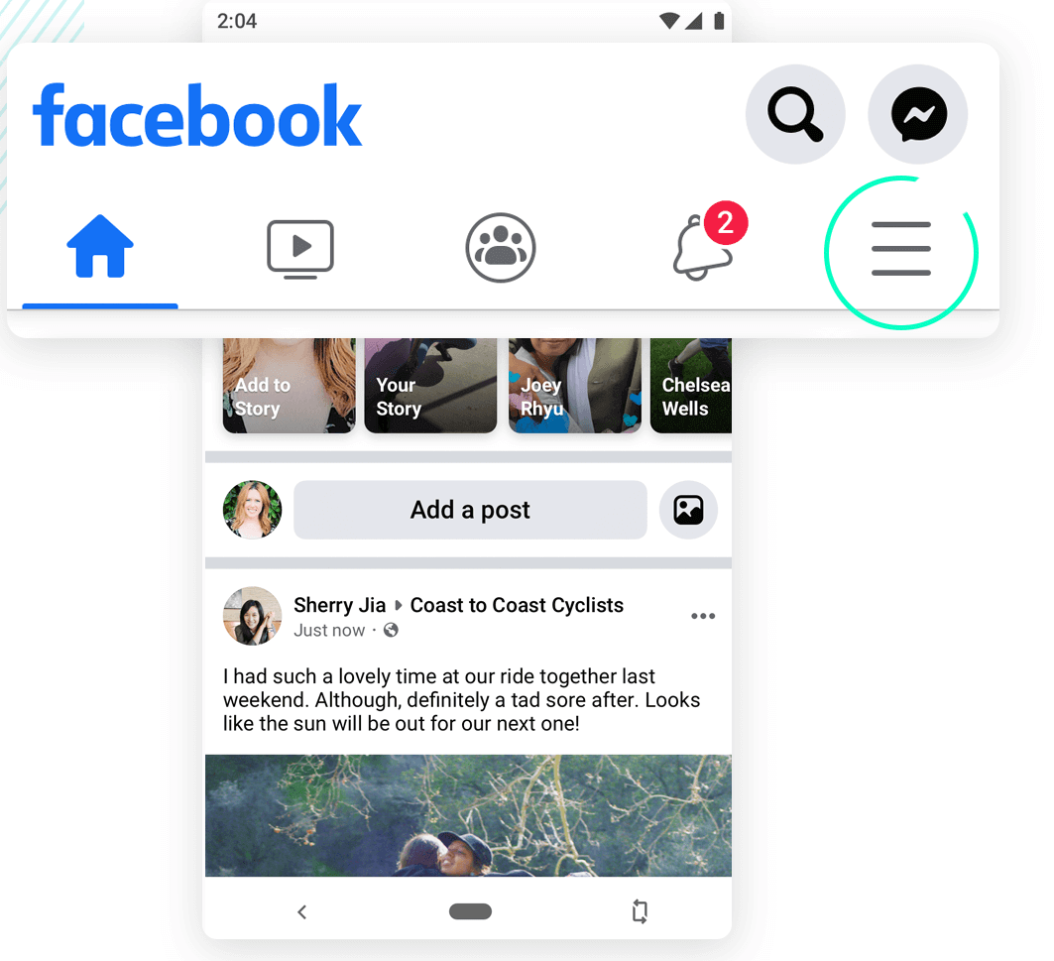
Navigation Patterns
Example
The Facebook.com image displays a hamburger menu with a top and bottom navigation bar.
Notes:
Instructor Note
Facebook uses a hamburger menu, a top navigation bar as well as a bottom navigation bar. Progressive Disclosure Menus: The filters shown in the vertical navigation menu are a form of progressive disclosure. Users can choose to interact with these filters to reveal more specific items or categories, thus disclosing information progressively as needed.
Vertical Navigation Menu: On the left side of the image, there is a column that lists categories, operating systems, and other filters. This is a vertical navigation menu that allows users to filter products based on various criteria.
"Software > Business & Office > Contact Management" is a classic example of breadcrumb navigation. Breadcrumbs provide a trail for the user to follow back to the starting or entry point of a navigation path and are often used in websites to give users a way to track their location within programs or documents.

Slide 47
Design Tips
It involves a collection of best practices and strategies aimed at improving the overall usability, functionality, and user experience of a product. These tips cover various aspects:
Enhance visibility
01
Use contrast, size, and placement to make navigation elements stand out
Simplify messaging
Use clear and descriptive navigation labels to ensure ease of use
02
Location indicators
03
Use breadcrumbs and interactive walkthroughs to help the user know their location in the app
Notes:
Instructor Note:
These tips concentrate on several areas, including interface visibility, communication clarity, and user orientation.
Design advice could cover things like making navigation elements stand out with contrast, size, and placement; using descriptive and easy-to-understand navigation labels to facilitate understanding; and adding interactive walkthroughs and breadcrumbs, among other location indicators, to help users keep track of where they are in an app or website.
All things considered, design tips provide insightful advice and industry best practices to streamline the design process and produce more natural and user-friendly interfaces.
Improve Visibility: Design navigation to be easily discoverable and accessible using contrasting colors, larger sizes, and clear icons placed in familiar locations.
Clear UX Copy: Ensure navigation labels are clear and descriptive, avoiding jargon and possibly including tooltips for further clarification.
Location Indicators: Use breadcrumbs, highlight the current menu item, or add interactive walkthroughs to help users know their location within the app.

Slide 48

Simplification and Consistency
These are fundamental principles in the design phase to improve user experience and comprehension.
Simple layout Reduce complexity to make navigation more intuitive
Consistent design
Maintain uniformity across the product to help users learn fast
Notes:
Instructor Note
Design simplification makes the product easier to navigate and more intuitive, while consistency maintains a uniform design throughout the product, improving user understanding and productivity.
Simplify Layouts: Aim for minimalism to enhance navigation intuitiveness.
Ensure Consistent Design: Uniformity across the platform aids in quicker learning. Discuss the layout in the image

Slide 49

Responsive Navigation and Testing
Design adaptable navigation that provides a uniform experience across all device types and screen sizes. The following image shows a responsive design that supports all devices.
Engage in continuous user testing to gather feedback on navigation effectiveness and implement required changes.
Notes:
Instructor Note Adapt the navigation design to different screen sizes and devices to ensure a seamless experience across all platforms.
Regularly test navigation with real users and iterate based on feedback to continuously improve the user experience.

Slide 50
Generating an Attention Insight Using Figma
15
Demonstrate the process of generating an attention insight using Figma
You are refining the user interface design for an e-commerce platform, focusing on grocery products, by utilizing Figma's Attention Insight plugin.
This demonstration explains how Figma facilitates the creation and evaluation of visual designs to effectively capture user attention. After loading images into newly created pages labeled Product Search and Profile, the process employs the Attention Insight plugin to generate heatmaps, focus maps, and contrast maps.
Note: Refer to the demo document for detailed steps:
04_Generating_an_Attention_Insight_Using_Figma
Notes:
Instructor Note:​
Please demonstrate the actions specified on the slide. Additionally, encourage the learners to actively participate by performing the tasks along with you during the demonstration.​
For further guidance, you can refer to the elaborated demo document.​
Please guide the learners to download the demo documents available on the Learning Management System (LMS) under the section titled 'Reference Materials'.

Slide 51
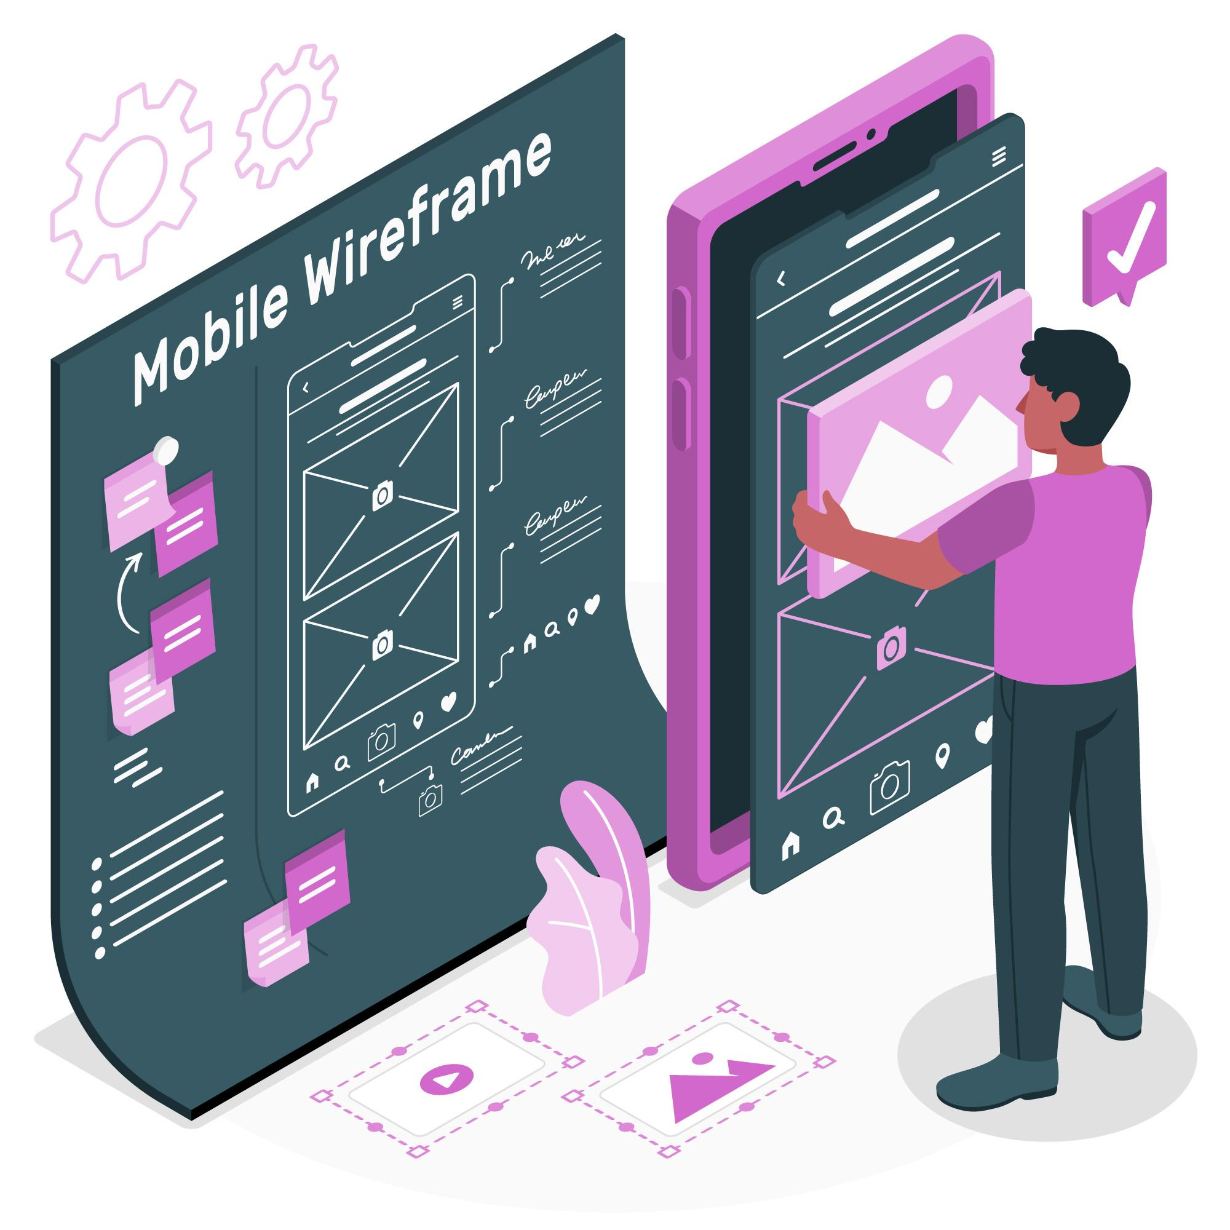
Wireframing
It is a visual guide that represents the skeletal framework of digital products. It
simplifies the layout of content and functionality on a page according to user needs.
Notes:
Instructor Note Wireframing is the initial blueprint for the structure and layout of a website or app. It's a low-fidelity visual representation that focuses on functionality and content organization, rather than visual design elements like color or imagery. Think of it as a skeletal framework that lays out the key areas of a webpage and how they will interact with each other.
Here are some key characteristics of wireframes:
Low-fidelity: Wireframes are typically created in black and white or grayscale, with simple shapes and boxes representing different content areas. This is to ensure the focus remains on structure and functionality, not aesthetics.
Focus on content and functionality: Wireframes show how users will navigate through the interface and where they will find the information they need.
Rapid iteration: Wireframes are meant to be easy to create and modify. This allows designers to quickly explore different layout options and get feedback from stakeholders early on in the design process.

Slide 52
Importance of Wireframing and Prototyping in Design Workflows
Enhances design and precision
01
Provides a clear layout for stakeholders and enables issue identification
Enhances efficiency
Supports rapid exploration of design options and quick iteration
02
Facilitates user testing
03
Assesses usability and user flow for direct feedback on design’s effectiveness
Notes:
Instructor Note Wireframing and prototyping are fundamental building blocks in the design workflow, especially when it comes to user experience (UX) design.
They are crucial in UX design, offering several key benefits: Clarity and Communication: Wireframes establish a shared vision, facilitating understanding among designers, developers, and stakeholders. They provide a clear layout and functionality overview, enabling early feedback and issue identification.
Efficiency and Iteration: Wireframes allow for rapid exploration of design options and quick iteration. By focusing on core functionalities, they aid in prioritization, streamlining the development process.
Usability Testing and Refinement: Prototypes, being more interactive, enable user testing to assess usability and user flow. Insights gathered from testing inform iterative refinement, ensuring continuous improvement to better meet user needs.

Slide 53

Generative AI Accelerates Wireframing and Prototyping
It accelerates the wireframing and prototyping stages of UI and UX design by automating and optimizing various processes. AI helps in the following tasks in the process:
Enhanced creative exploration
Rapid exploration
Personalized user experience
Streamlined iteration
Notes:
Instructor Note Generative AI automates the creation of wireframes and prototypes, significantly accelerating the design phase.
AI tools can generate multiple design options based on specified criteria, offering designers a broader spectrum of ideas to consider.
Allows for rapid adjustments and iterations based on feedback, with AI suggesting improvements or alternatives.
AI can tailor wireframes and prototypes to match user data, predicting user preferences and behaviors for more targeted testing.

Slide 54
Imagine you are a mobile app designer tasked with optimizing screen space on small devices. In mobile app navigation design, which navigation pattern takes precedence over others to conserve screen space by concealing the primary navigation menu?
Tooltip pattern
Spotlight pattern
Breadcrumbs
Hamburger menu
Notes:
Mode: Sync
Estimated duration: 5 minutes
Type: Poll Question
Instructor Note:
Conduct the poll and, if necessary, reteach key points based on the results before starting with the next topic.
Provide feedback or explanations after the poll, where appropriate, so learners can understand why certain answers are correct or incorrect.
If most of the class is getting the poll incorrect, then there is a gap in their understanding. Prompt the learners to highlight which concepts are unclear to them and teach those topics for the understanding of the whole class. Move onto the next topic when the class is confident in their understanding of the section.
Correct Answer: D
Explanation: Hamburger Menu is a navigation pattern designed to maximize screen space on mobile devices by collapsing the main menu options into a compact, three-line icon resembling a hamburger. When users tap or click on this icon, the full navigation menu expands, allowing access to all options without cluttering the screen.

Slide 55
Architectural design serves as a conceptual model that outlines the structure of a system and delineates how its components interact within a given framework.
UI and UX are closely interrelated, with UI focusing on the visual aspects of design and UX emphasizing the overall feel and user interaction.
Generative AI brings transformative capabilities to every stage of UI/UX design, significantly boosting creativity and efficiency in the design process.
Personalization involves dynamically adjusting content, features, and interactions to suit the unique characteristics, behaviors, and histories of individual users.
Wireframing acts as the preliminary sketch that establishes the structure and layout of a website or application.
Notes:
Mode: Sync
Estimated duration: 5 mins
Type: Instructor-led activity

Slide 56
Implementing Generative AI in Framer for E-commerce Prototyping
15
Demonstrate the process of implementing generative AI in framer for e-commerce prototyping
You are developing a responsive web design for 'Fresh Start Groceries', an e-commerce platform, using Framer to generate and enhance user interfaces.
This demonstration explains how Framer is leveraged to create a dynamic and responsive webpage for an online grocery store. Starting with generating a homepage that features a navigation bar, search field, and product sections like 'Featured Products' and 'Deals of the Day', the process involves using AI prompts to design subsequent pages for categories and product details.
Note: Refer to the demo document for detailed steps:
05_Implementing_Generative_AI_in_Framer_for_E-commerce_Prototyping
Notes:
Instructor Note:​
Please demonstrate the actions specified on the slide. Additionally, encourage the learners to actively participate by performing the tasks along with you during the demonstration.​
For further guidance, you can refer to the elaborated demo document.​
Please guide the learners to download the demo documents available on the Learning Management System (LMS) under the section titled 'Reference Materials'.

Slide 57
Building and Enhancing a PHP E-Commerce Website Using Generative AI
15
Demonstrate the process of building and enhancing an e-commerce website using generative AI
You are tasked with developing and refining a PHP-based e-commerce website for a grocery store, leveraging generative AI to streamline the creation process.
This demonstration details how generative AI, particularly ChatGPT, assists in generating the initial PHP scripts for a grocery e-commerce homepage with static sample data. The process involves creating a structured homepage that includes featured products, navigation, and a footer.
Note: Refer to the demo document for detailed steps:
06_Building and Enhancing a PHP E-Commerce Website Using Generative AI
Notes:
Instructor Note:​
Please demonstrate the actions specified on the slide. Additionally, encourage the learners to actively participate by performing the tasks along with you during the demonstration.​
For further guidance, you can refer to the elaborated demo document.​
Please guide the learners to download the demo documents available on the Learning Management System (LMS) under the section titled 'Reference Materials'.

Slide 58
30
In this project, we delve into the practical application of generative AI prompts to expedite the frontend development process for a grocery e-commerce website.
By leveraging ChatGPT, we aim to streamline the creation of essential web pages such as contact, shop, and cart pages. The goal is to ensure seamless site navigation, facilitated by XAMPP as the local server environment and PHP for backend scripting.
Task:
Create a contact page for the grocery website using ChatGPT
Generate a cart page for the grocery website through ChatGPT
Generate CSS script to fix header and footer
Notes:
Mode: Sync
Estimated duration: 20 to 30 mins
Type: Small-Group Activity/Individual activity
Instructure Note:
Instruct the learners to download the guided practice from the LMS present under the reference material and complete the exercise.
Facilitate the guided practice exercise.
Monitor breakout rooms. (in case of group work)
Outside of Bootcamps, this activity is an individual exercise, with the instructor assisting learners in completing it independently in the live class.

Slide 59
Creating a Frontend Starter Code for a Taxi Ride Booking Application Using Generative AI
The objective is to develop frontend starter code for the Book_A_Taxi ride booking application using Generative AI tools. The primary task is to use
AI-driven prompts to establish the foundational code structure for the website.
By participating in this project, learners will gain hands-on experience in frontend development, specifically in building a taxi ride booking application.
Task:
Generate a frontend starter code for a taxi ride booking application
Create additional pages for the website, including About Us, Services, and Contact pages
Link all pages together to ensure seamless navigation within the website
Add a new page for booking a ride for various services and link it with existing pages
Implement basic form validation for the booking form on the website
Notes:
Mode: async
Estimated duration: 5 mins (assignment walkthrough)
Type: Individual Activity

Slide 60
Notes:
Mode: Sync
Estimated duration: 5 to 10 mins
Type: Whole-Group Activity

